Slide 1
How much did you use time
On your life?

Slide 2
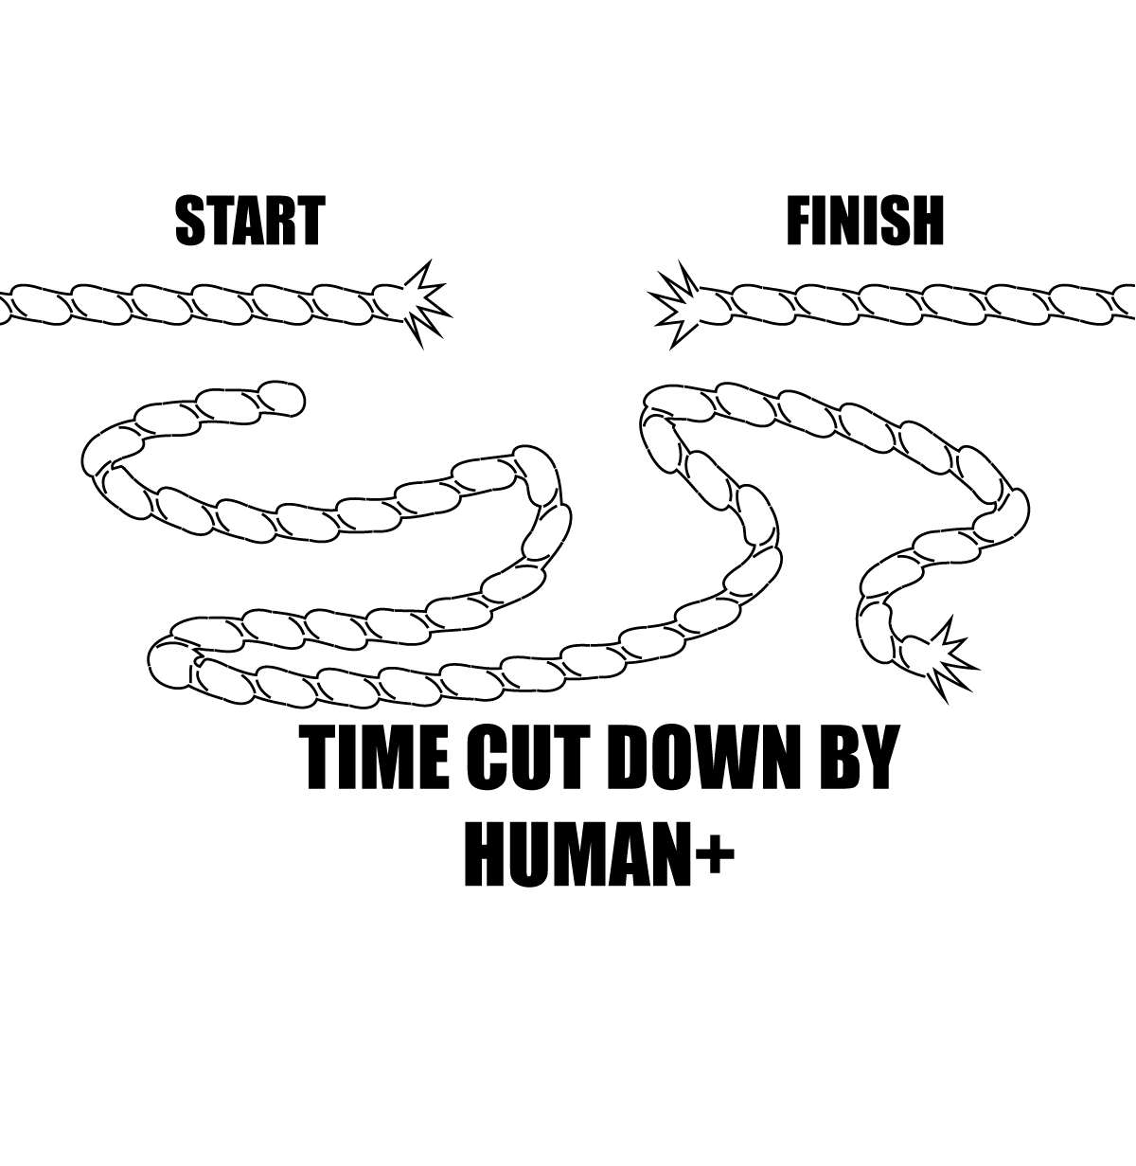
??????????????????????

Slide 3
HUMAN+ Bionic Chip

Slide 4
?

Slide 5
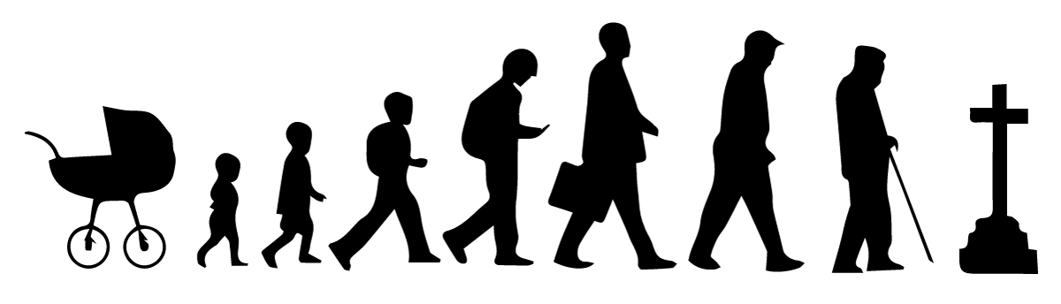
TRADITIONALLY
HUMAN+
Limited information gained in a traditional way
+ most of the time you were just horsing around.
Full knowledge
of quantum
Physics and meaning of life

Slide 6
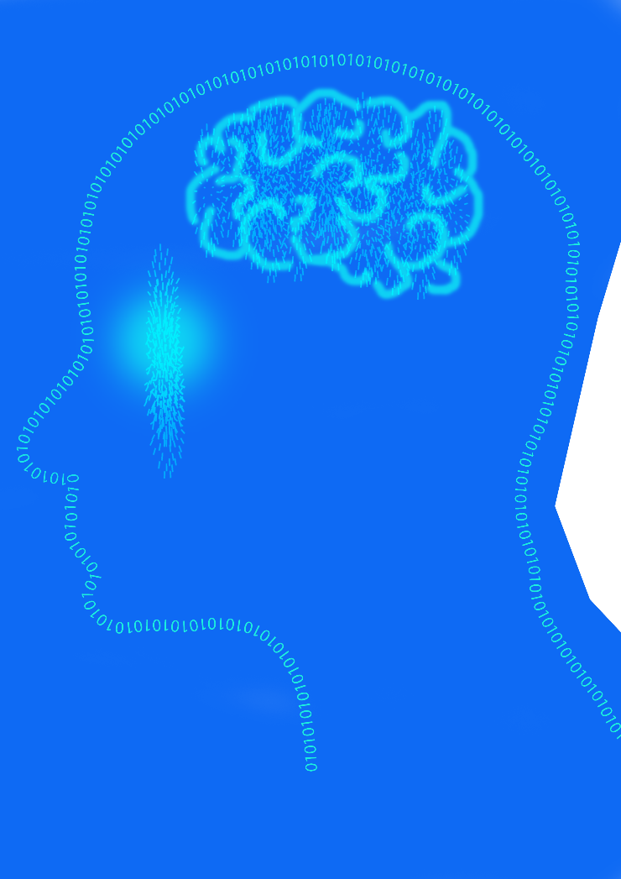

Slide 7


Slide 8
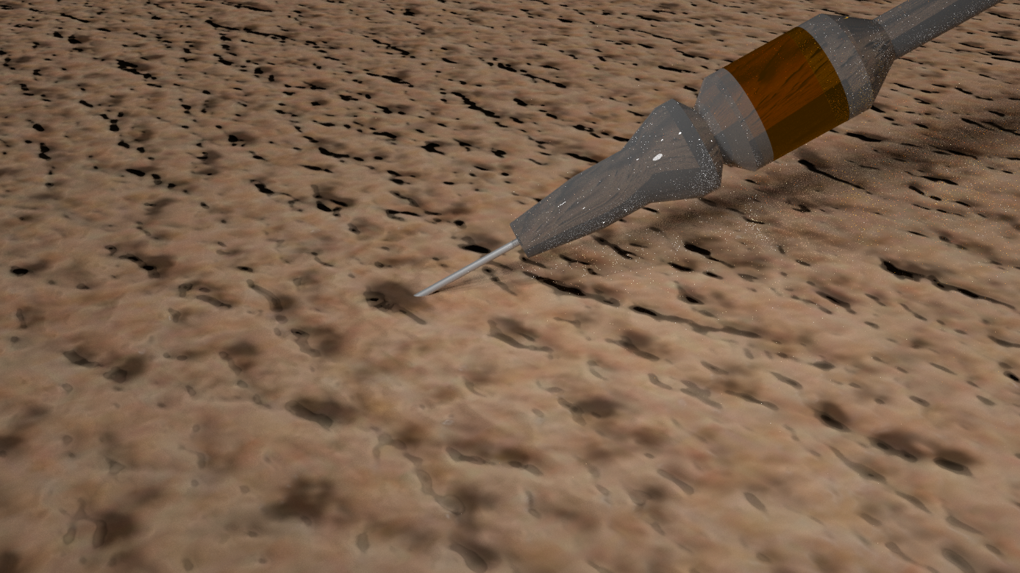
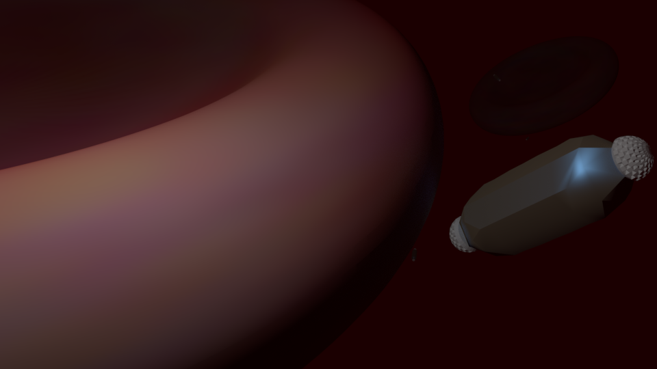
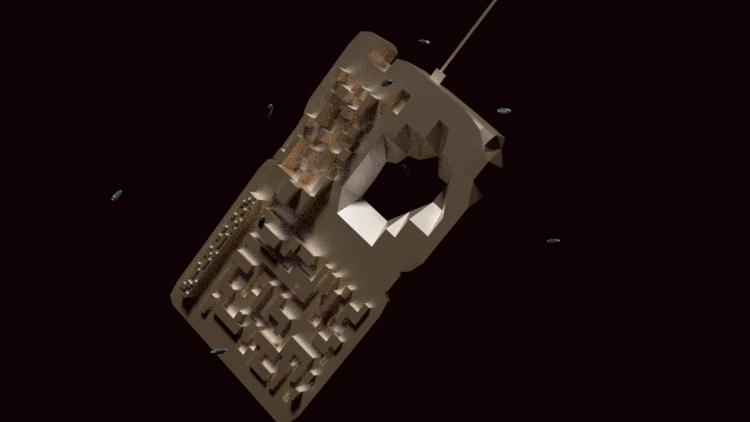

Slide 9

Wont get rejected!

Slide 10
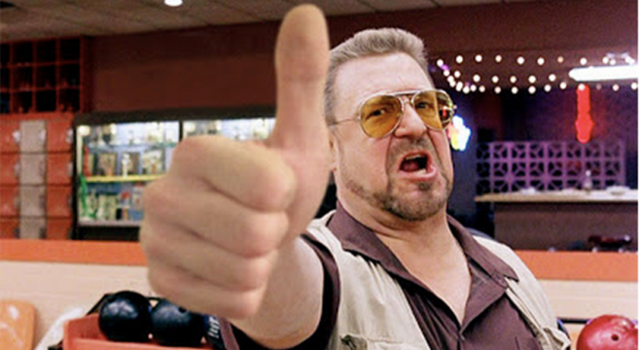

Slide 11
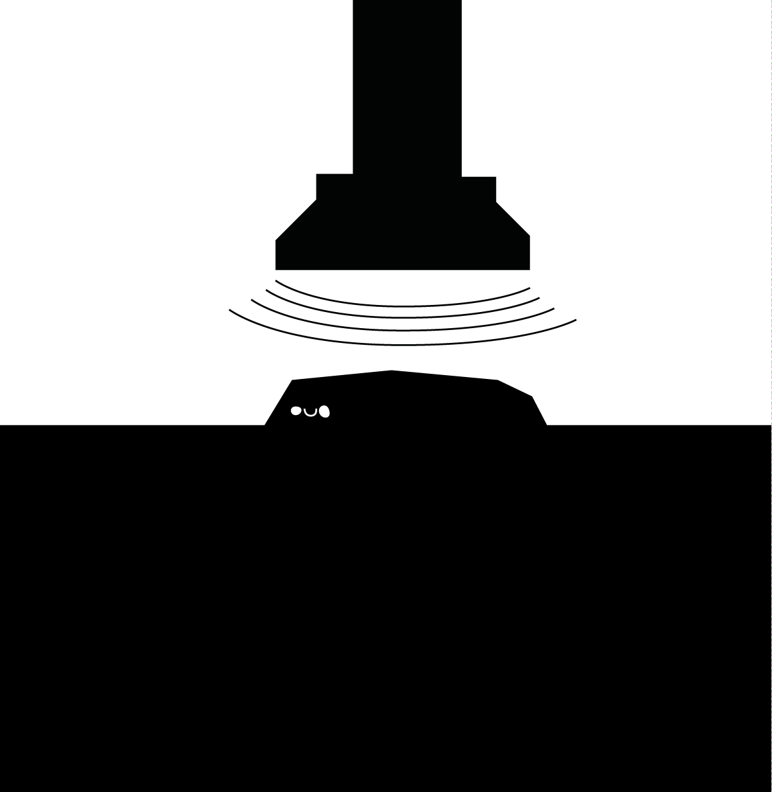

Slide 13
